Slide 1
Clean Architecture En Elixir

Slide 2
Productivity
Complexity
Time

Slide 3
Development complexity
¿ Incidental complexity ?
¿ Essential complexity ?

Slide 4
What is software architecture ?
Develop
Shape
Components Communication
maintenance
Arrangement
Operation

Slide 5
Architecture Goals
Express a Propose
Flexibility to change a decision
Delay decisions until the right time

Slide 6
How can we separate essential complexity of Incidental complexity ?

Slide 7
Domain Driven Architectures

Slide 8
Time Line
2005 - Hexagonal Architecture
Principles
Explicitly separate Application, Domain, and Infrastructure
Alistair Cockburn
a.k.a Ports and Adapters

Slide 9
Time Line
2005 - Hexagonal Architecture
Example: A application will search poems in an external system: a file. We could also connect this application to a database, the principles would be identical

Slide 10
Time Line
2005 - Hexagonal Architecture
Principies
Dependencies are going from Application and Infrastructure to the Domain
Everything depends on the Domain, the Domain does not depend on anything

Slide 11
Time Line
2005 - Hexagonal Architecture
The hexagonal architecture uses the metaphor of ports and adapters to represent the interactions between inside and outside.
Ports (Behavior) are defined by the business, so they are inside

Slide 12
Time Line
2005 - Hexagonal Architecture

Slide 13
Time Line
2005 - Hexagonal Architecture

Slide 14
Time Line
2005 - Hexagonal Architecture
Dependency Inversion

Slide 15
Dependency Inversion

Slide 16
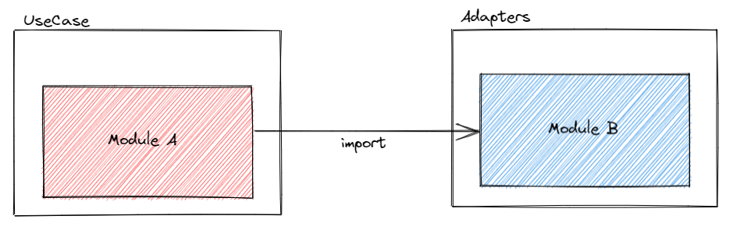
How not to do it...
Dependency Inversion on Elixir

Slide 17
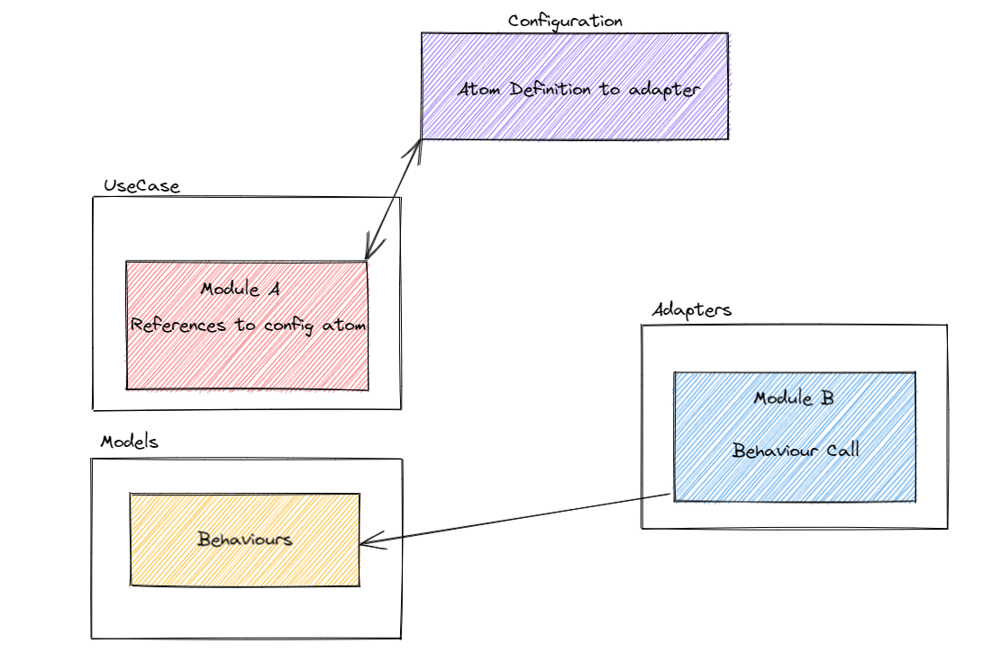
How to do it...
Dependency Inversion on Elixir

Slide 18
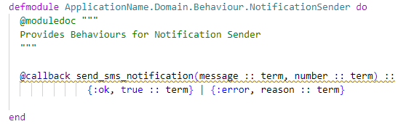
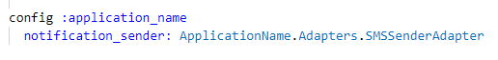
Sample of Dependency Inversion on Elixir
Creating Behaviour
Configuration (dev.exs, prod.exs, test.exs)

Slide 19
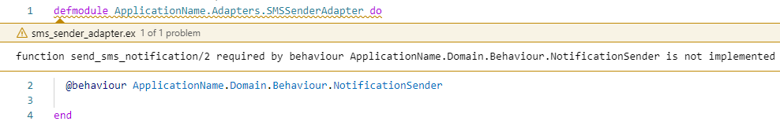
Sample of Dependency Inversion on Elixir
Creating Adapter and Implementing Behaviour

Slide 20
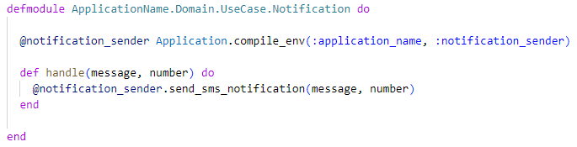
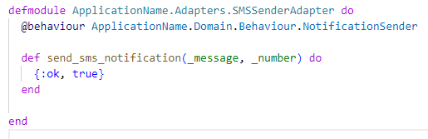
Sample of Dependency Inversion on Elixir
After implements Behaviour
Use Case usage

Slide 21
Time Line
2005 - Hexagonal Architecture
Remember
Explicitly separate Application, Domain, and Infrastructure
Dependencies are going from Application and Infrastructure to the Domain
We isolate the boundaries by using Ports and Adapters

Slide 22
Time Line
2008 - Onion Architecture
2005 - Hexagonal Architecture
2012 - Clean Architecture
They all have the same objective, which is the separation of concerns.
isolating the application core from the infrastructure concerns
Robert C. Martin

Slide 23
Time Line
2008 - Onion Architecture
2005 - Hexagonal Architecture
2012 - Clean Architecture

Slide 24
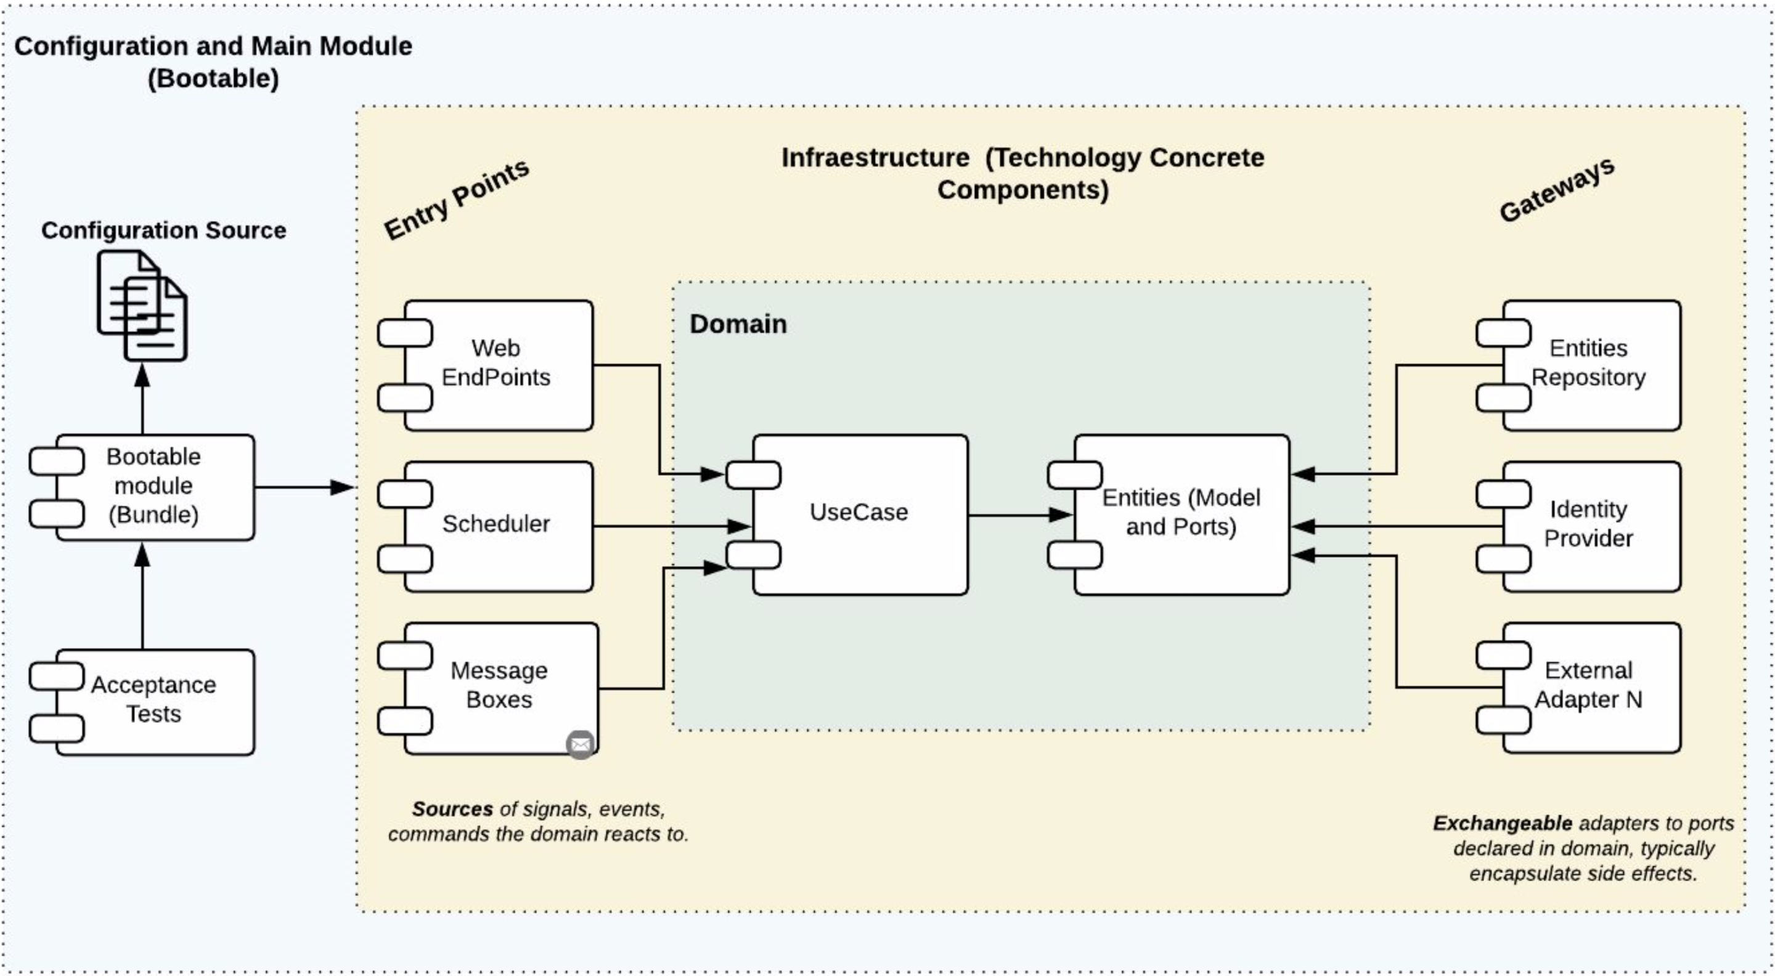
Clean Architecture

Slide 25
Clean Architecture
Thanks !!

